Slide 1
Capstone Project
The battle of the neighbourhood – Western London

Slide 2
Project Overview
I visited London recently and found that the accommodations are very expensive as compared to the other European countries. When I was choosing an Airbnb apartment, I had difficulty choosing which area to stay. With this project, I hope to be able to help other tourists, like myself, choose a neighbourhood to stay in based on selected preferences. For example, Chinese restaurants, theatres, museums, etc. As there are too many neighborhoods in London, I will just focus on Western Districts.
The targeted customers for my project will be tourists who are new to London, tourists who are trying to identify a new neighbourhood to stay, or simply for tourists who are looking for a new neighbourhood to visit.
Using the solution, the customers select a list of venues based on their preferences. Using the venues selected, the customers will be recommended neighbourhood(s) to visit.

Slide 3
Data Used
The following data sources are used for the project:
Wiki List of postal codes of Western London. From this Wiki page, I will be able to extract the list of Postal code and Neighborhood in Western London.
Google Map Platform. Using the Google Map API, I will be able to retrieve Latitude and Longtitude Data based on Postal Code.
Foursquare. Finally, using the Lat and Long value, I will be able to retrieve popular venues within a neighborhood.
These data will be merged to form a Analytic dataset that will contain top 160 venues for each neighbourhood. This dataset will be the basis for running Kmeans.

Slide 4
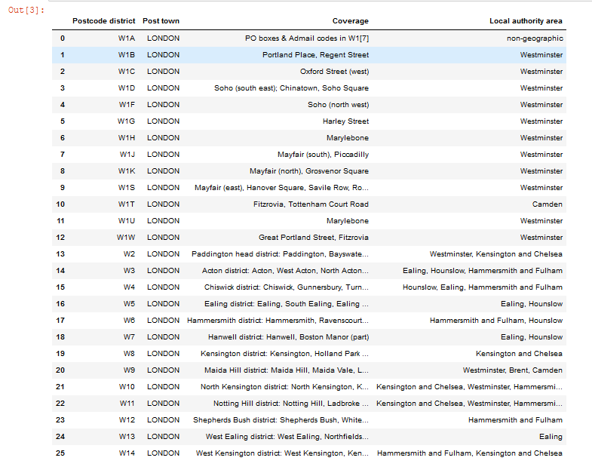
Data Used - Wiki
Scrapped Data from Wiki

Slide 5
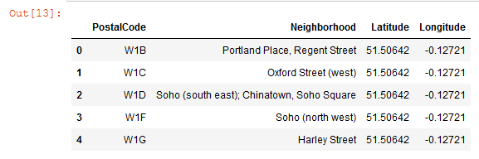
Data Used – Google Map
The Latitude and Longitude information are provided by Google Map Platform. To retrieve the information, this API is used,
g = geocoder.arcgis('{}, United Kingom, London'.format(postal_code))
Latitude and Longitude retrieved based on Postal Code

Slide 6
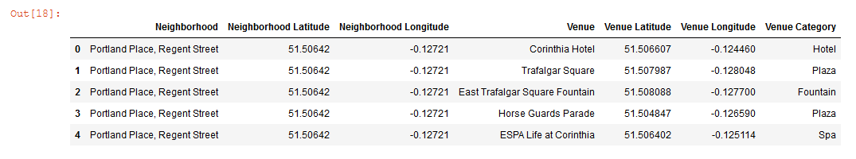
Data Used – Foursquare API
Venue information required for this project is provided by Foursquare API. To make use of the API, an account must be registered in www.foursquare.com.
For the purpose of this project, the radius of search has been set to 5oo meters and the venues returned is limited to 100.
Venue Category from Foursquare API

Slide 7
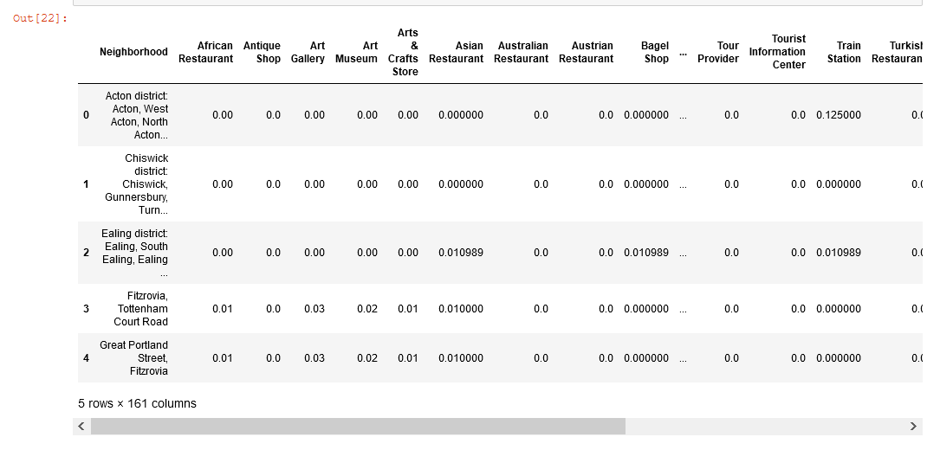
Prepared Data for Clustering
This is the format of the data required for clustering:
Venue Categories are merged into a single row based Neighborhood instead of multiple rows. In total, there are 160 venue categories.
Mean of frequency of venue is calculated for each venue categories.
Finally, the Neighborhood column is removed.
Clustering Data

Slide 8
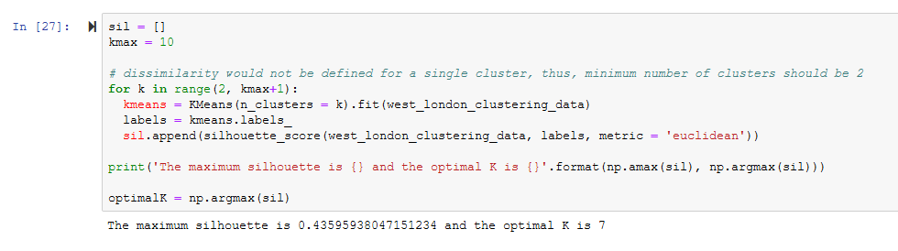
Kmeans and Silhouette
Kmeans clustering algorithm is used for this project. The parameter required for this algorithm is the number of clusters. To identify the optimal cluster, the model is executed several times with different values of n and the silhouette is used to evaluate the model.
The optimal cluster is n is 7 and the corresponding silhouette is 0.436.
Identifying the optimal number of cluster

Slide 9
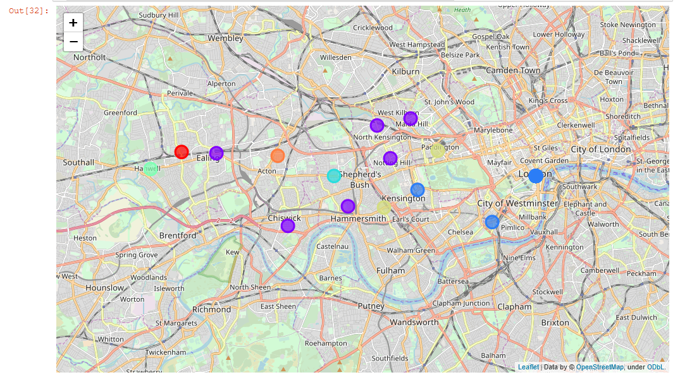
Visualization of the 7 clusters
From the map, there are 5 neighbourhoods in cluster 1, the largest cluster. The neighbourhoods have the following venues: Pub, Italian Restaurant, Bookstore, Café, Bakery, Coffee Shop, Supermarket, Yoga Studio, Creperie, Restaurant.
The second largest cluster is 2, with 3 neighbourhoods. The neighbourhoods have the following venues: Hotel, Wine Bar, Plaza, Theatre, Outdoor Sculpture, Art Gallery, Monument / Landmark, Mexican Restaurant, Garden, Cocktail Bar.
Finally, the third largest cluster is 5, with 2 neighbourhoods. The neighbourhoods have the following venues: Hotel, Café, Coffee Shop, Pub, Italian Restaurant, Restaurant, Garden, Fast Food Restaurant, Lebanese Restaurant, Hostel.

Slide 10
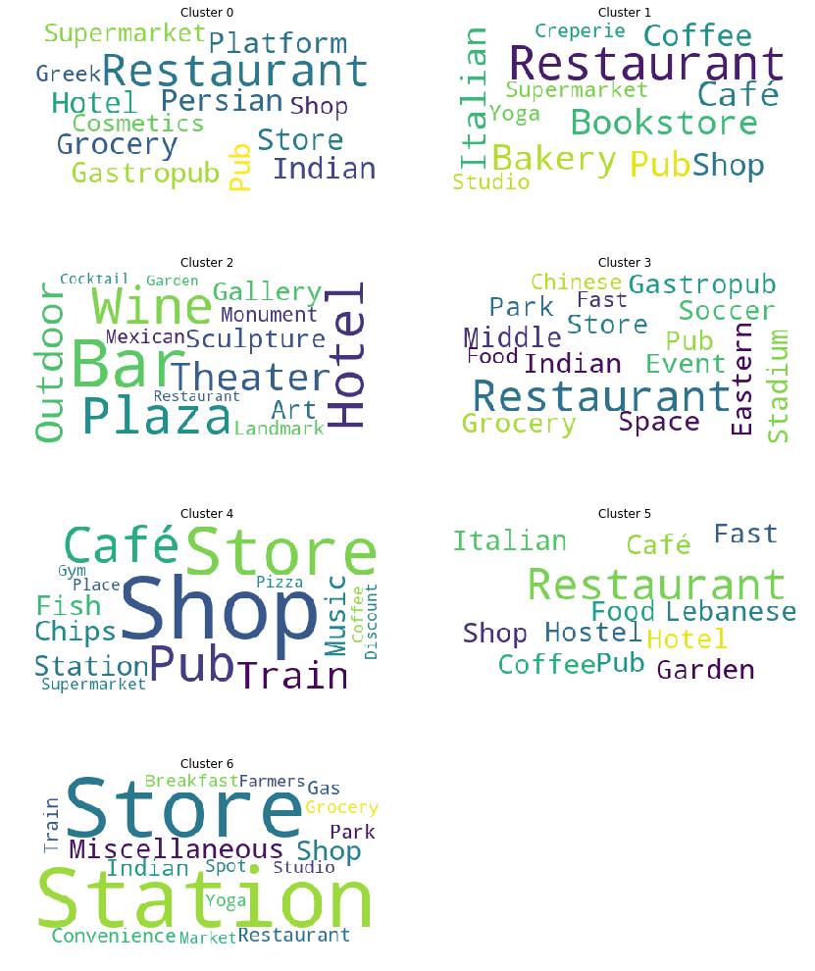
Visualization of the 7 clusters (cont)
Cluster 0 consists of Hotel, Store/Shop and Restaurant
Cluster 1 consists of Bakery, Café, Bookstore, Pub and Restaurants.
Cluster 2 consists of Bar, Theatre, Gallery, Monument and Hotel.
Cluster 3 consists of Park, Stadium and Restaurant.
Cluster 4 consists of Café, Shop/Store, Pub and Train Station.
Cluster 5 consists of Restaurants, Hostel, and Garden.
Cluster 6 consists of Store, Park and Station.

Slide 11
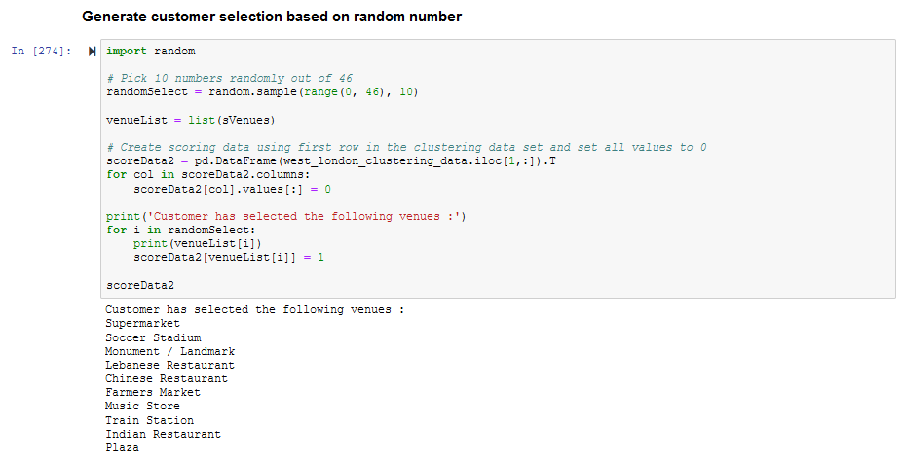
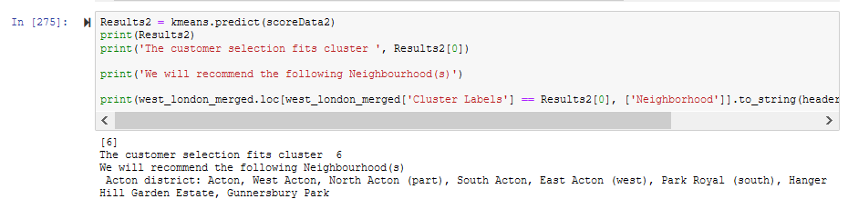
Conclusion (Cont’)
Automate Neighbourhood recommendation using the Kmeans model
Here is another where selection is made randomly using a generator.

Slide 12
Q & A

Slide 13
Thank you

